Slide 1
Course 4 Project SQL for Data Analysis and Insights
By Shashvat Shori
(October 15 Batch)

Slide 2
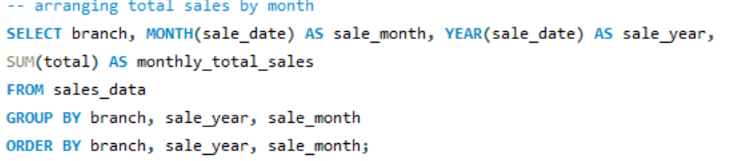
Task 1

Slide 3
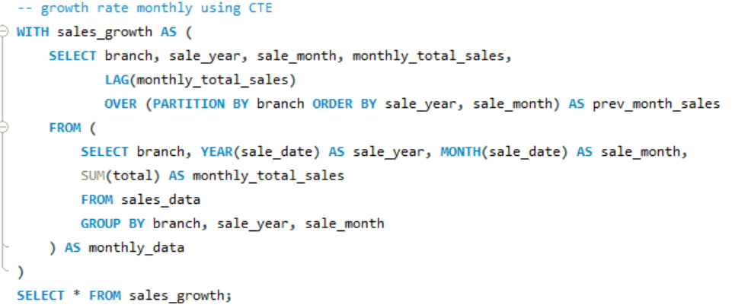
Task 1
branch | sale_year | sale_month | monthly_total_sales | prev_month_sales
A | 2019 | 1 | 38681.13 | NULL
A | 2019 | 2 | 29860.12 | 38681.13
A | 2019 | 3 | 37659.12 | 29860.12
B | 2019 | 1 | 37176.06 | NULL
B | 2019 | 2 | 34424.27 | 37176.06
B | 2019 | 3 | 34597.34 | 34424.27
C | 2019 | 1 | 40434.68 | NULL
C | 2019 | 2 | 32934.98 | 40434.68
C | 2019 | 3 | 37199.04 | 32934.98

Slide 4
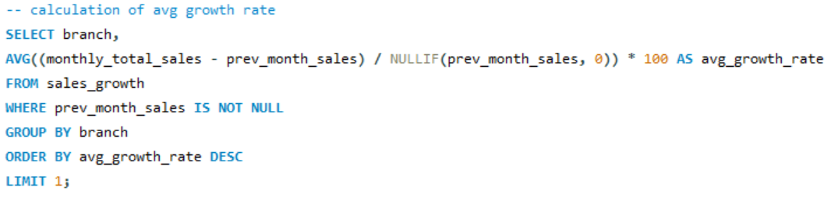
Task 1
branch | avg_growth_rate
A | 1.657014
C | -2.80039
B | -3.44964
branch | avg_growth_rate
A | 1.657014

Slide 5
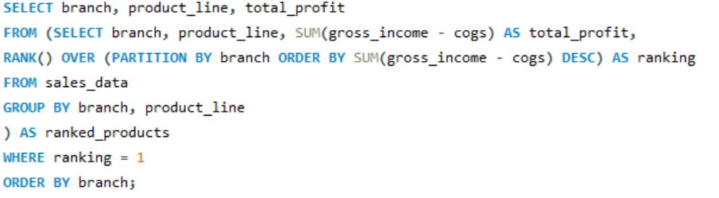
Task 2
branch | product_line | total_profit
A | Health and beauty | -11398
A | Fashion accessories | -14777
A | Food and beverages | -15528.5
A | Electronic accessories | -16572.6
A | Sports and travel | -17527.7
A | Home and lifestyle | -20282.2
B | Food and beverages | -13765.9
B | Fashion accessories | -14850.1
B | Electronic accessories | -15427.5
B | Home and lifestyle | -15877.8
B | Health and beauty | -18077.7
B | Sports and travel | -18084.6
C | Home and lifestyle | -12572.2
C | Sports and travel | -14260.8
C | Health and beauty | -15032.9
C | Electronic accessories | -17162.4
C | Fashion accessories | -19506.7
C | Food and beverages | -21503.3
branch | product_line | total_profit
A | Health and beauty | -11398
B | Food and beverages | -13765.9
C | Home and lifestyle | -12572.2

Slide 6
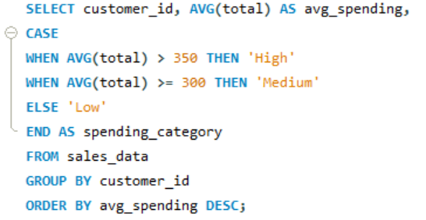
Task 3
customer_id | avg_spending | spending_category
8 | 397.5275 | High
3 | 349.2875 | Medium
2 | 349.1385 | Medium
15 | 343.5524 | Medium
1 | 337.829 | Medium
12 | 329.1007 | Medium
11 | 324.2246 | Medium
13 | 319.1464 | Medium
14 | 318.9303 | Medium
10 | 309.3124 | Medium
6 | 308.865 | Medium
7 | 307.8819 | Medium
9 | 293.4567 | Low
5 | 293.0155 | Low
4 | 263.5331 | Low

Slide 7
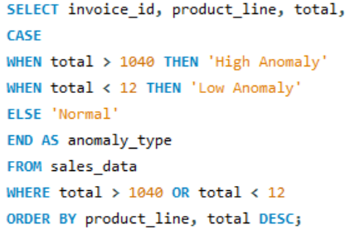
Task 4
invoice_id | product_line | total | anomaly_type
860-79-0874 | Fashion accessories | 1042.65 | High Anomaly
784-21-9238 | Sports and travel | 10.6785 | Low Anomaly

Slide 8
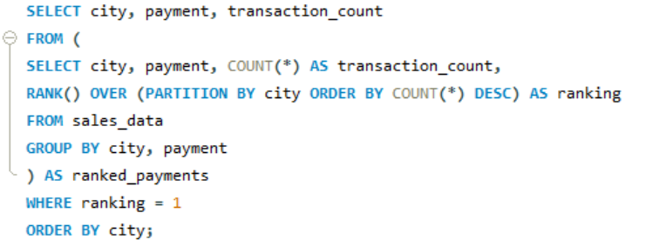
Task 5
city | payment | transaction_count
Mandalay | Ewallet | 113
Mandalay | Cash | 110
Mandalay | Credit card | 109
Naypyitaw | Cash | 124
Naypyitaw | Ewallet | 106
Naypyitaw | Credit card | 98
Yangon | Ewallet | 126
Yangon | Cash | 110
Yangon | Credit card | 104
city | payment | transaction_count
Mandalay | Ewallet | 113
Naypyitaw | Cash | 124
Yangon | Ewallet | 126

Slide 9
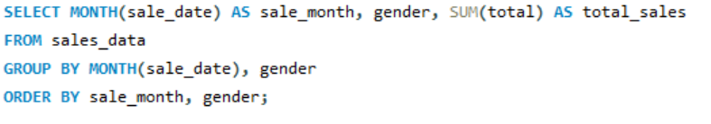
Task 6
sale_month | gender | total_sales
1 | Female | 59138.98
1 | Male | 57152.89
2 | Female | 56335.56
2 | Male | 40883.82
3 | Female | 52408.39
3 | Male | 57047.12

Slide 10
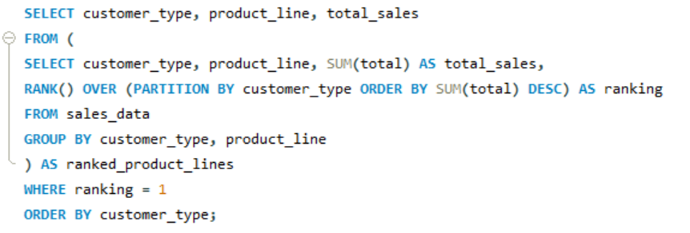
Task 7
customer_type | product_line | total_sales
Member | Food and beverages | 31357.62
Normal | Electronic accessories | 29839.04

Slide 11
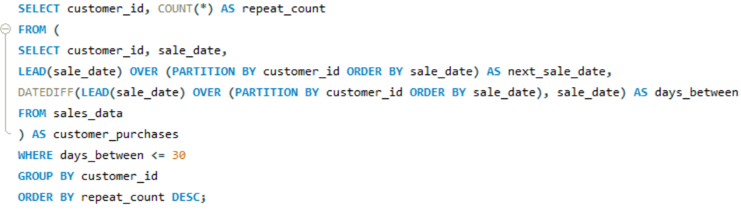
Task 8
customer_id | repeat_count
1 | 66
2 | 66
3 | 66
4 | 66
5 | 66
6 | 66
7 | 66
8 | 66
9 | 66
10 | 66
11 | 65
12 | 65
13 | 65
14 | 65
15 | 65

Slide 12
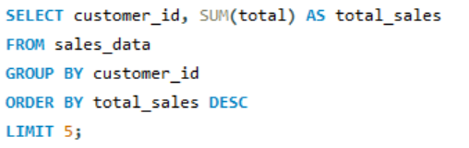
Task 9
customer_id | total_sales
8 | 26634.34
3 | 23402.26
2 | 23392.28
15 | 22674.46
1 | 22634.55

Slide 13

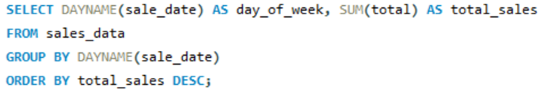
Task 10
day_of_week | total_sales
Saturday | 56120.81
Tuesday | 51482.25
Thursday | 45349.25
Sunday | 44457.89
Friday | 43926.34
Wednesday | 43731.14
Monday | 37899.08

Slide 14
Thank You

